Slide 1
Unit 7 Series-Parallel Circuits
Part A: Identifying Series and Parallel Circuits

Slide 2
What will you learn?
Identify series and parallel connections in a circuit.

Slide 3
Introduction
Many circuits are series-parallel circuits, i.e. a mix of series and parallel connections.
To make circuit analysis simple, the first step is to identify sections of
series connections, and
parallel connections.
The next step is to simplify these series and parallel connections to their equivalent resistances.
Then we may apply circuit laws and rules for circuit analysis.

Slide 4
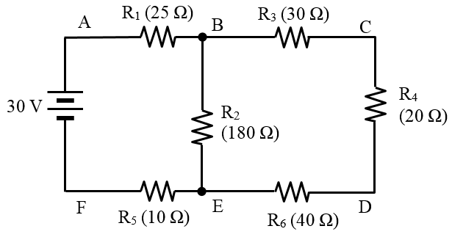
Identifying a Series Connection
The first step to analyze a given circuit is to identify any basic connection such as a series connection.
Any circuit displaying a series connection can be grouped and dealt with.
Here, path B-C–D–E is one
but not path A–B–E–F.

Slide 5

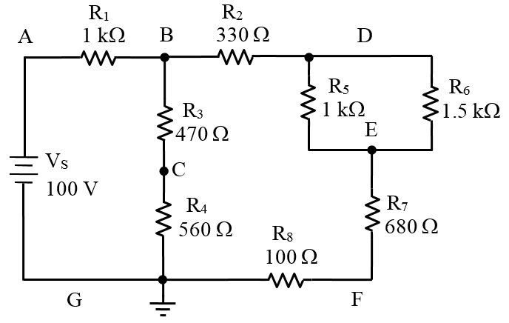

Example 1: Identify series connections in the circuit.
There are two paths:
Path B–C–G
Path E–F–G
But not
Path A–B–D
Path A–B–C–G

Slide 6
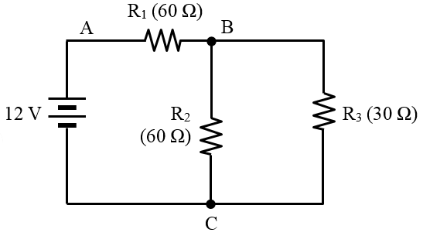
Identifying a Parallel Connection
Any circuit displaying a parallel connection can also be grouped and dealt with.
∵ R₂ and R₃ are both connected across nodes B & C.
∴ R₂ and R₃ are connected in parallel.

Slide 7
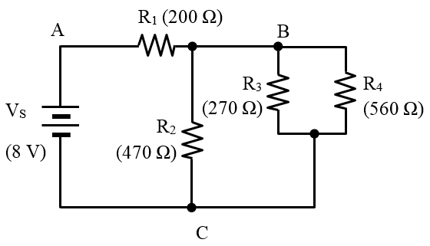
Example 2: Identify parallel connections in the circuit.
∵ R₂, R₃ and R₄ are all connected across nodes B & C.
∴ R₂, R₃ and R₄ are connected in parallel.

Slide 8
You have learned that
The first step in analyzing a series-parallel circuit is to identify the series and parallel connections.

Slide 9
Coming Up Next
Analyzing Series-Parallel Circuits

